Slide 1
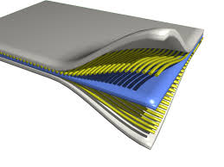
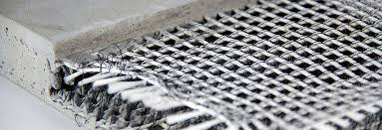
Theory of machines Wessam Al Azzawi
Lecture 1: Introduction to composite materials
At the end of this you will:
An understanding of what are composite materials
What are the various types of composite materials
How they are designed
Why they are used

Slide 2
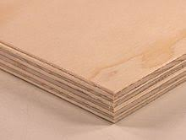
Theory of machines Wessam Al Azzawi
Lecture 1: Introduction to composite materials
What are composite materials?
A composite material is made by combining two or more materials – often ones that have very different properties. The two materials work together to give the composite unique properties. However, within the composite you can easily tell the different materials apart as they do not dissolve or blend into each other
Natural composites
Wood is a composite – it is made from long cellulose fibers held together by a much weaker substance called lignin. Cellulose is also found in cotton, but without the lignin to bind it together it is much weaker. The two weak substances – lignin and cellulose – together form a much stronger one.

Slide 3
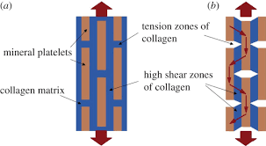
Theory of machines Wessam Al Azzawi
Lecture 1: Introduction to composite materials
Natural composites
The bone in your body is also a composite. It is made from a hard but brittle material called hydroxyapatite (which is mainly calcium phosphate) and a soft and flexible material called collagen. Collagen would not be much use in the skeleton but it can combine with hydroxyapatite to give bone the properties that are needed to support the body

Slide 4
Theory of machines Wessam Al Azzawi
Lecture 1: Introduction to composite materials
Early composites
For many thousands of years, mud bricks were best example for composite materials. Mud can be dried out into a brick shape to give a building material. It is strong if you try to squash it (it has good compressive strength) but it breaks quite easily if you try to bend it (it has poor tensile strength). Straw seems very strong if you try to stretch it, but you can crumple it up easily. By mixing mud and straw we can get bricks that are resistant to both squeezing and tearing and make excellent building blocks.
Another example is concrete. Concrete is a mix of aggregate (small stones or gravel), cement and sand. It has good compressive strength. Adding metal rods or wires to the concrete can increase its tensile (bending) strength. Concrete containing such rods or wires is called reinforced concrete.

Slide 5
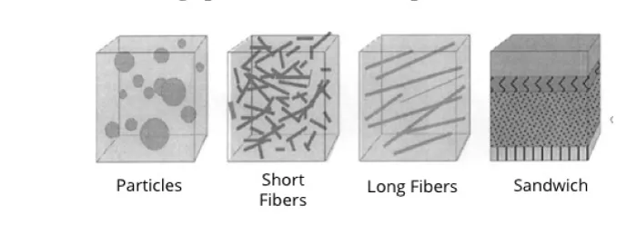
Theory of machines Wessam Al Azzawi
Lecture 1: Introduction to composite materials
Making composites
Most composites are made of just two materials. One is the matrix or binder. It surrounds and binds together fibres or fragments of the other material, which is called the reinforcement.

Slide 6
Theory of machines Wessam Al Azzawi
Lecture 1: Introduction to composite materials
Definition and types
Wood (lignin + celullose)
Concrete (gravel + cement)
Hypoeutectoid steel (ferrite + pearlite)
Reinforced concrete (gravel + cement + steel)
Austenitic stainless steel (grains =)
Cement
Cellophane (Multiple polymeric layers)
Reinforced plastic (it doesn’t improve its properties)
Paper (only cellulose fibers)
Composite material
Limit of composite material
Not a composite material

Slide 7
Theory of machines Wessam Al Azzawi
Lecture 1: Introduction to composite materials
Advantages and disadvantages of composite materials
Advantages
High Mechanical Properties
• Flexibility of Design Options
• Ease of Fabrication
• Light Weight
• Corrosion Resistant
• Impact Resistant
• Excellent Fatigue Strength
Disadvantages
Brittle Failure Mechanisms
High Material Costs
High Manufacturing Costs
Temperature Limitations
Actual Mechanical Properties not Always as Good as Expected
Mechanical Properties Very Process Dependent

Slide 8
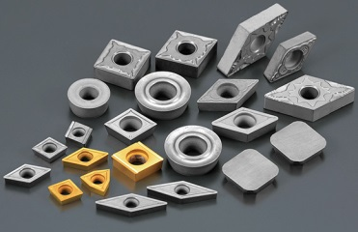
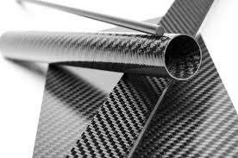
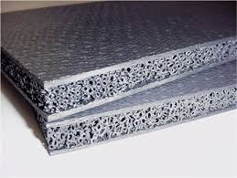
Theory of machines Wessam Al Azzawi
Lecture 1: Introduction to composite materials
What are the various types of composite materials?
According to the matrix material
Metal Matrix Composites (reinforced metals) – MMC
Polymer Matrix Composites (reinforced polymers) – PMC
Ceramic Matrix Composites (ceramic, glass) - CMC

Slide 9
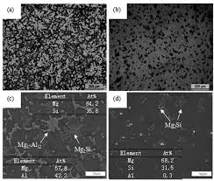
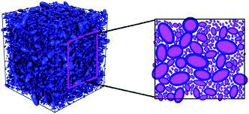
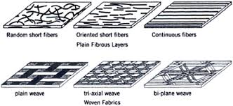
Theory of machines Wessam Al Azzawi
Lecture 1: Introduction to composite materials
What are the various types of composite materials?
According to the structure or geometry of the reinforcement
Dispersive composites - contain very fine particles
Particulate composites (particulate, granular) - contain larger particles of regular shapes (spheres, platelets) or irregular shapes
Fibrous composites - contain long or short fibers that may be oriented or unoriented, be of various origins (glass, carbon, polymeric, textile, etc.)

Slide 10
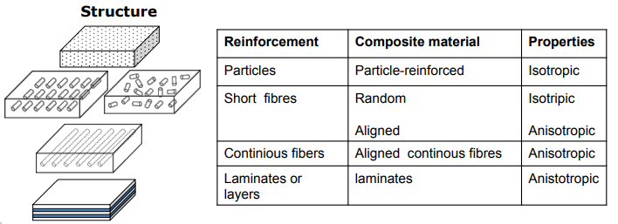
Theory of machines Wessam Al Azzawi
Lecture 1: Introduction to composite materials
What are the various types of composite materials?
Structures, reinforcements, types and properties of composite Materials

Slide 11
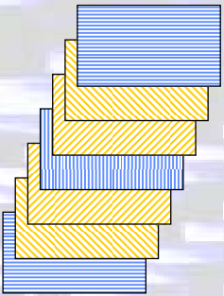
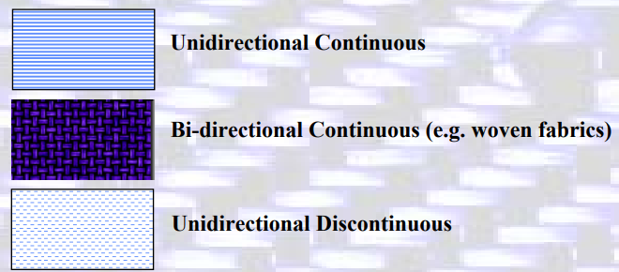
Theory of machines Wessam Al Azzawi
Lecture 1: Introduction to composite materials
What are the various types of composite materials?
Basic Building Blocks of Fiber-Reinforced Composites
Layers, lamina

Slide 12
Theory of machines Wessam Al Azzawi
Lecture 1: Introduction to composite materials
Applications of composites
Most widely used form of FRP is a lamina structure, made
by stacking and bonding thin layers of fiber and polymer
until desired thickness is obtained
By varying fiber orientation among layers, a specified level
of anisotropy in properties can be achieved in the laminate
Applications: parts of thin cross-section, such as aircraft wing and fuselage sections, automobile and truck body panels, and boat hulls
– Aerospace Industries (Carbon/Epoxy PMCs)
– Automobile Industry (Epoxy based PMCs)
– Springs and bumper systems (Reinforced Thermosets)
– Tooling (Epoxy based PMCs)
– Fiberglass reinforced plastic has been used for boat hulls, fishing rods, tennis rackets, golf club shafts, helmets, skis, bows and arrows

Slide 13
Theory of machines Wessam Al Azzawi
Lecture 1: Introduction to composite materials
Applications of composites
Space craft: Antenna structures, Solar reflectors, Satellite structures, Radar, Rocket engines, etc.
Aircraft: Jet engines, Turbine blades, Turbine shafts, Compressor blades, Airfoil surfaces, Wing box structures, Fan blades, Flywheels, Engine bay doors, Rotor shafts in helicopters, Helicopter transmission structures, etc.
Miscellaneous: (1) Bearing materials, Pressure vessels, Abrasive
materials, Electrical machinery, Truss members, Cutting tools, Electrical brushes, etc.
Automobile: Engines, bodies, Piston, cylinder, connecting rod, crankshafts, bearing materials, etc.

Slide 14
Theory of machines Wessam Al Azzawi
Lecture 1: Introduction to composite materials
Applications of composites
Light Weight Application
Automotive body parts by composites mainly CFRP and GFRP
GFRP, CFRP, SMC for seat structures
Formula one uses CFRP extensively
CFRP is used in road and mountain bikes and also in road bikes made of Al the seat posts handle bars, and forks
Fuel tanks made up of Kevlar reinforced rubber

Slide 15
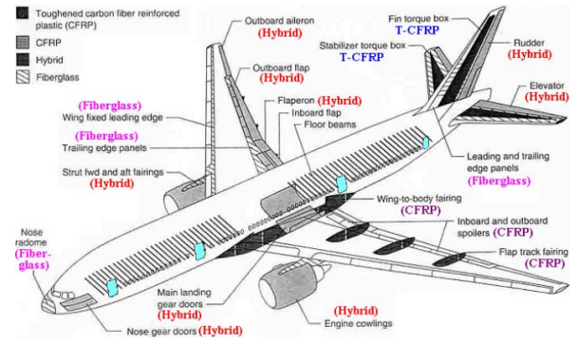
Theory of machines Wessam Al Azzawi
Lecture 1: Introduction to composite materials
Applications of composites
Composites in a Boeing 777

